Slide 1
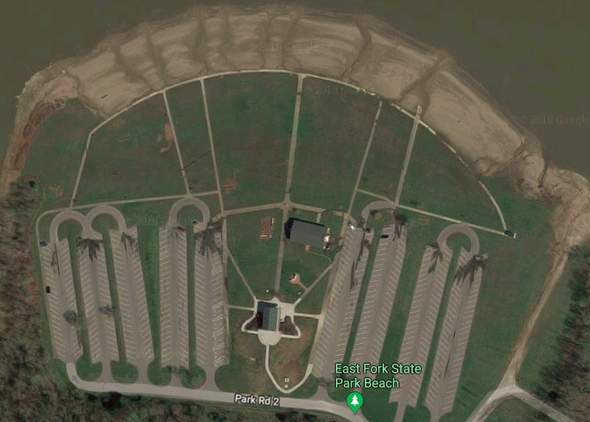
2018 Venue Map
Finish Line and Results Tent
Loading and Unloading Docks
Portolets
Shuttle Stop
Bow Markers
Stage
EMT
Food Vendors
Picnic Tables
Boats Only – No Boat trailers or Team Tents
Spectators
Team Tents
Store
Picnic Tables
Oars
Reserved Parking
Boat Trailers

Slide 2
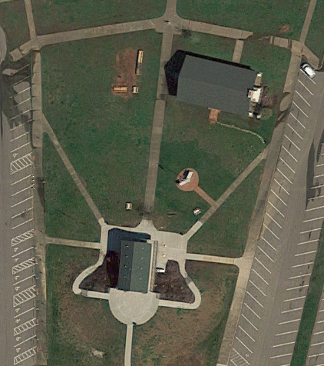
Small Tent –
Shop / Results
Awards
Registration
Volunteers
Radio Charge
Weigh Ins
ICE

