Slide 1
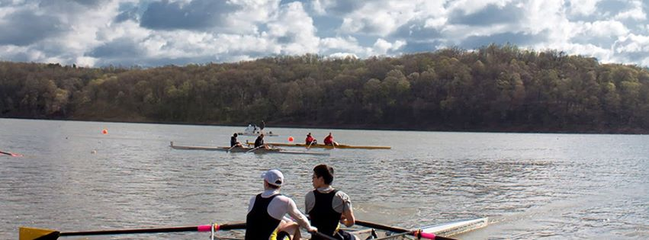
Midwest Scholastic
Rowing Championships
May 13 & 14, 2017
Dillon Lake, Nashport OH

Slide 2
The Midwest Scholastic Rowing Association (MSRA) was organized in 1983 with two purposes: first, to sponsor a midwest scholastic championship regatta each spring and second, to organize midwest scholastic/junior regatta scheduling and information exchange. From a humble beginning of ten schools and two clubs attending the first Midwest Rowing Championship Regatta in Culver, Indiana competing in 14 events for boys and 7 events for girls, we have grown to hosting 48 high school teams competing in 40 events. Close to 8,000 athletes, coaches, parents, friends and families are expected to be in the Zanesville/Muskingum County area for the 2017 Championship Regatta. MSRA had the honor of hosting the 2016 SRAA National Championships Regatta. 10,000 athletes and their entourages attended the National Regatta.
The Midwest Scholastic Rowing Association along with the Dillon Lake LOC are proud to bring the Midwest Scholastic Rowing Championships on Saturday, May 13, 2017 and Sunday, May 14, 2017. The championship regatta feature the fastest crews in scholastic rowing competing on a newly developed course with a spectacular spectator venue and the ability to see the entire race course, a feature rarely witnessed in scholastic rowing.
The Midwest Scholastic Rowing Association is offering a wonderful opportunity for you to join with the community in supporting these spectacular event. Various sponsorship opportunities are available to individuals, businesses, and organizations. Donations and in-kind gifts are also accepted with appreciation.
Tax receipts will be issued for all sponsorships, donations and in-kind gifts. Sponsorships will be available through May 1, 2017. Further details are outlined in the enclosed sponsorship package. Please feel free to contact us with any questions relating to these opportunities.
Please join us for our extraordinary, remarkable events.
Dillon Lake Local Organizing Committee
Executive Director – Lisa Osborne
dillonlakeloc@gmail.com

Slide 3
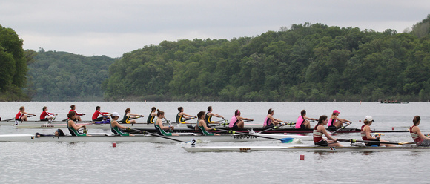
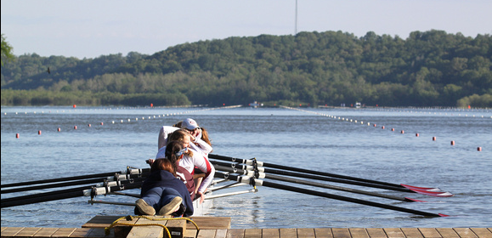
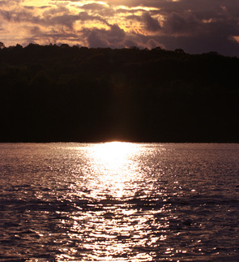
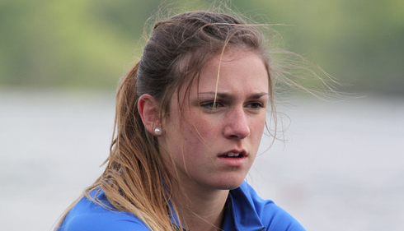
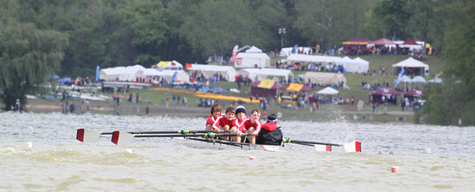
2016
Championship Regatta at Dillon Lake State Park
………
Nashport, OH
At the start…
Lining Up
Determination
A beautiful sunset by the lake
A great venue with a remarkable view

Slide 4
MIDWEST SCHOLASTIC ROWING CHAMPIONSHIP SPONSOR LEVELS
SCHOLASTIC SUPREME LEVEL - NEGOTIABLE
The Scholastic Supreme Level Sponsor is the foremost regatta sponsor and will be recognized as the sponsor of the 2017 Midwest Scholastic Rowing Association Championship Regatta.
The Scholastic Supreme Level Sponsor will receive:
Exclusive rights to sponsorship of the Midwest Scholastic Rowing Association Championship Regatta
Branding across all official media (TV, radio, print, electronic)
Full page inside front cover advertisement in the Midwest Scholastic Rowing Association Championship Regatta Brochure
Recognition with name and logo on the regatta website
Banner opportunities in multiple locations throughout the regatta area
Reserved bleacher seating for 10 during the regatta
“POWER TEN” STARTING LINE LEVEL - $10,000
The “Power Ten” Level Sponsor is the major sponsor of the Regatta starting line.
The Regatta Starting Line sponsor will have exclusive signage at the launch docks and finish line to show proper recognition
The “Power Ten” starting line sponsor will receive:
Exclusive naming rights to the 2017 Midwest Scholastic Rowing Association Championship Regatta Starting Line
Branding across all official media (TV, radio, print, electronic)
Full page back cover advertisement in the 2017 Midwest Scholastic Rowing Association Championship Regatta Brochure
Recognition with name and logo on the regatta website
Banner opportunities in multiple locations throughout the regatta area

Slide 5
MIDWEST SCHOLASTIC ROWING CHAMPIONSHIP SPONSOR LEVELS
CHAMPIONSHIP LEVEL - $7,500
The Championship Level Sponsor is the major sponsor of the Fan Viewing Area.
The Championship Level Sponsor will receive:
Exclusive naming rights to Fan Viewing Area
Branding across all official media (TV, radio, print, electronic)
Full-page advertisement in the 2017 Midwest Scholastic Rowing Association Championship Regatta Brochure
Recognition with name and logo on the regatta website
Banner opportunities labeling the official Fan Viewing Area Sponsor
REGATTA LEVEL - $5,000
Three opportunities for Regatta Level sponsorship will be available;
One Regatta Level Sponsor is the major sponsor of the Registration Tent
One Regatta Level Sponsor is the major sponsor of the Awards Stage
One Regatta Level Sponsor is the major sponsor of Transportation and Shuttles
The Regatta Level Sponsor will receive:
Exclusive naming rights to one of the three areas listed above
Branding across all official media (TV, radio, print, electronic)
Full-page advertisement in the 2017 Midwest Scholastic Rowing Association Championship Regatta Brochure
Recognition with name and logo on the regatta website
Banner opportunities labeling the area’s official sponsor

Slide 6
MIDWEST SCHOLASTIC ROWING CHAMPIONSHIP SPONSOR LEVELS
BOATHOUSE LEVEL - $2,500
There are no limits to the number of Boathouse Sponsors.
The Boathouse Level Sponsor will receive:
Branding across all official media (TV, radio, print, electronic)
Full-page advertisement in the 2017 Midwest Scholastic Rowing Association Championship Regatta Brochure
Recognition with name and logo on the regatta website
Banner opportunities at all events where possible
CAPTAIN LEVEL - $1,000
There are no limits to the number of Captain Sponsors.
The Captain Level Sponsor will receive:
Named as an event sponsor in media releases
Full-page advertisement in the 2017 Midwest Scholastic Rowing Association Championship Regatta Brochure
Recognition with name and logo on the regatta website
Banner opportunities at all events where possible
COXSWAIN LEVEL - $500
There are no limits to the number of Coxswain Sponsors.
The Coxswain Level Sponsor will receive:
Named as an event sponsor in media releases
Half-page advertisement in the 2017 Midwest Scholastic Rowing Association Championship Regatta Brochure
Recognition with name and logo on the regatta website
3 x 4 banner opportunities Regatta tent entry location for all to see.

Slide 7
MIDWEST SCHOLASTIC ROWING CHAMPIONSHIP SPONSOR LEVELS
ROWER LEVEL - $250
There are no limits to the number of Rower Level Sponsors.
The Rower Level Sponsor will receive:
Named as an event sponsor in media releases
Quarter-page advertisement in the 2017 Midwest Scholastic Rowing Association Championship Regatta Brochure
Recognition with name and logo on the regatta website
2 x 3 banner opportunities Regatta tent entry location for all to see.
STROKE LEVEL - $100
There are no limits to the number of Stroke Sponsors.
The Stroke Level Sponsor will receive:
Business card-sized advertisement in the 2017 Midwest Scholastic Rowing Association Championship Regatta Brochure
Recognition on banner Regatta tent entry location for all to see.
ALUMNI/FAMILY/INDIVIDUAL LEVEL - $50
There are no limits to the number of Alumni/Family/Individual Sponsors.
The Alumni/Family/Individual Level Sponsor will receive:
Supporter listing in the 2017 Midwest Scholastic Rowing Association Championship Regatta Brochure
Recognition on banner Regatta tent entry location for all to see.
“HIGH-FIVE” LEVEL - $10
There are no limits to the number of “High-Five” Sponsors.
The “High-Five” Level Sponsor will receive:
“Shout out” for rower/team listing in the 2017 Midwest Scholastic Rowing Association Championship Regatta Brochure
“Shout out” announcements recognizing individual rower/team on the day of the regatta

Slide 8
MIDWEST SCHOLASTIC ROWING CHAMPIONSHIP SPONSOR LEVELS
IN-KIND SPONSORSHIPS - VARIETY AVAILABLE
Many items are required to run a regatta of this level.
In-kind donations provide a valuable and appreciated opportunity to be part of the 2017 Midwest Scholastic Rowing Championship Regatta.
We are looking for assistance with:
Communications (wireless communications for all regatta personnel and timing)
Sanitation (Porta-Johns, trash receptacles and trash disposal)
Printing (programs, signage and banners)
Bleachers (transportation of, set up)
Tents/Tables/Chairs
Food Donations for staff and referees
Traffic/Parking/Shuttle services (traffic cones, parking attendant vests)
Media Sponsors (TV, radio, print)
To be a sponsor or donor of the 2017 Midwest Scholastic Rowing Championship Regatta, please complete the attached form and return the form and payment to us by May 01, 2017.
If you wish to use your company logo in your ad, camera-ready artwork or a digital file is preferred, but we can certainly work with print artwork.
Thank you for your support!

Slide 9
MIDWEST SCHOLASTIC ROWING CHAMPIONSHIP SPONSOR LEVELS
SPONSORSHIP LEVELS
Please check one
SCHOLASTIC SUPREME LEVEL Please call 614-361-7712 for information
“POWER TEN” LEVEL ………… $10,000
CHAMPIONSHIP LEVEL …….. $7,500
REGATTA LEVEL ……………….. $5,000
BOATHOUSE LEVEL ………….. $2,500
CAPTAIN LEVEL ………………… $1,000
COXSWAIN LEVEL …………….. $500
ROWER LEVEL ………………….. $250
STROKE LEVEL ……………….... $100
ALUMNI & FAMILY LEVEL … $50
“HIGH FIVE” LEVEL ………..... $10
IN-KIND ……………………………. Description: ________________________________________
COMPANY / INDIVIDUAL NAME ___________________________________________________
STREET ADDRESS ______________________________________________________________
CITY _________________________________ STATE ______________ ZIP ______________
CONTACT NAME ______________________________________________________________
PHONE NUMBER __________________________ FAX NUMBER ________________________
EMAIL __________________________________
Mail this form and payment to: Dillon Lake LOC, P.O. Box 3206 Parkersburg, WV 26103
Questions: call Lisa Osborne – (614)361-7712
To send a digital logo or ad for inclusion, email image file to dillonlakeLOC@gmail.com
Deadline for submission is May 01, 2017 unless otherwise specified in your sponsorship level

