Slide 1
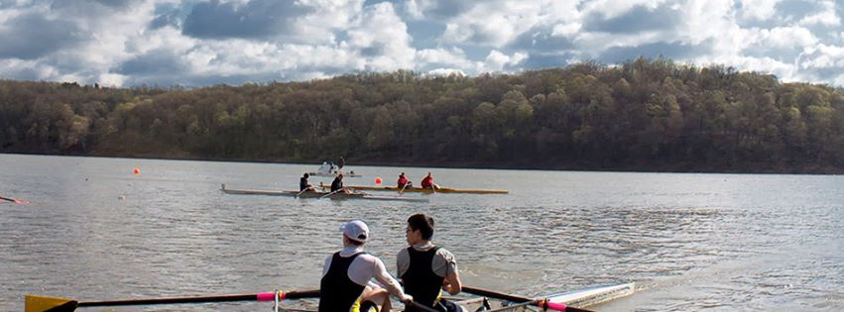


Rowing for Gold at Dillon
Dillon Lake, Nashport OH

Slide 2

The Midwest Scholastic Rowing Association (MSRA) was organized in 1983 with two purposes: first, to sponsor a midwest scholastic championship regatta each spring and second, to organize midwest scholastic/junior regatta scheduling and information exchange. In 2012, MSRA contracted with the Ohio State Parks Department with the purpose of developing a championship worthy regatta site and course at Dillon Lake in Nashport, Ohio. A 1500m competition course, starting platform and dock system have been purchased and installed at Dillon Lake. From a humble beginning of ten schools and two clubs attending the first Midwest Rowing Championship Regatta in Culver, Indiana competing in 14 events for boys and 7 events for girls, we have grown to hosting multiple scholastic regattas and the expectation of collegiate events in the near future.
Midwest Scholastic Rowing Association along with the Dillon Lake LOC will be hosting three regattas in 2016: the Dillon Lake Scholastic Sprints on Saturday, April 16, 2016; Midwest Scholastic Rowing Championships on Saturday, May 14, 2016 and Sunday, May 15, 2016 and the National Championships on Friday, May 27, 2016 and Saturday, May 28, 2016. These championship regattas feature the fastest crews in scholastic rowing competing on a newly developed course with a spectacular spectator venue and the ability to see the entire race course, a feature rarely witnessed in scholastic rowing.
The Midwest Scholastic Rowing Association is offering a wonderful opportunity for you to support Rowing for Gold at Dillon. Various sponsorship opportunities are available to individuals, businesses, and organizations. Donations and in-kind gifts are also accepted with appreciation.
Tax receipts will be issued for all sponsorships, donations and in-kind gifts. Further details are outlined in the enclosed sponsorship package. Please feel free to contact us with any questions relating to these opportunities.
Please join us for our extraordinary, remarkable events.
Dillon Lake Local Organizing Committee
Executive Director – Lisa Osborne
dillonlakeloc@gmail.com

Slide 3
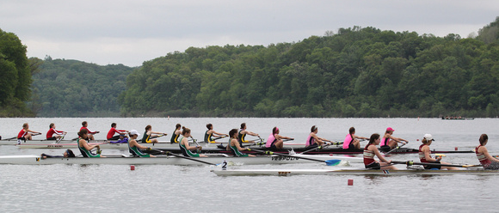
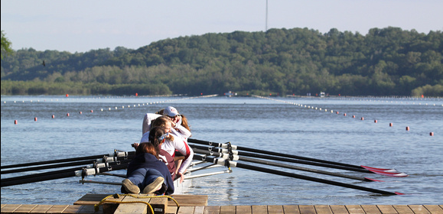
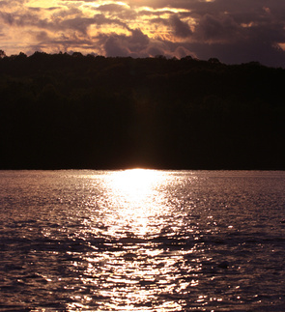
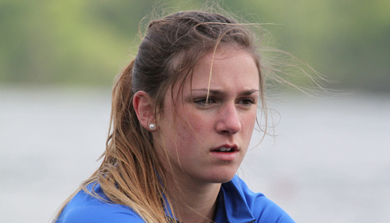
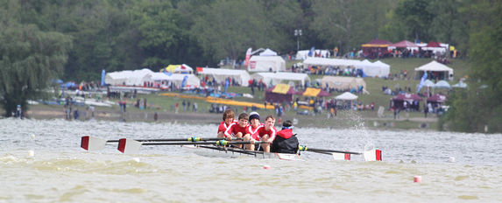
Rowing for Gold at Dillon Lake State Park
………
Nashport, OH
At the start…
Lining Up
Determination
A beautiful sunset by the lake
A great venue with a remarkable view

Slide 4
ROWING for GOLD at DILLON SPONSOR LEVELS
SCHOLASTIC SUPREME LEVEL
The Scholastic Supreme Level Sponsor is the foremost regatta sponsor and will be recognized as the sponsor of the Midwest Scholastic Rowing Association Regattas.
The Scholastic Supreme Level Sponsor will receive:
  Exclusive naming rights of the Midwest Scholastic Rowing Association Regattas
  Branding across all official media (TV, radio, print, electronic)
  Full page inside front cover advertisement in the 2016 Midwest Scholastic Rowing Association Regatta Brochure
  Recognition with name and logo on the regatta website
  Banner opportunities in multiple locations throughout the regatta area
  Reserved bleacher seating for 10 during the regatta
POWER TEN LEVEL - $10,000
The Power Ten Level Sponsor is the major sponsor of the Regatta starting line.
The Regatta Starting Line sponsor will have exclusive signage at the launch docks and finish line to show proper recognition
The Power Ten starting line sponsor will receive:
  Exclusive naming rights to the 2016 Midwest Scholastic Rowing Association Regatta Starting Line
  Branding across all official media (TV, radio, print, electronic)
  Full page back cover advertisement in the 2016 Midwest Scholastic Rowing Association Regatta Brochure
  Recognition with name and logo on the regatta website
  Banner opportunities in multiple locations throughout the regatta area

Slide 5
ROWING for GOLD at DILLON SPONSOR LEVELS
CHAMPIONSHIP LEVEL - $7,500
The Championship Level Sponsor is the major sponsor of the Fan Viewing Area.
The Championship Level Sponsor will receive:
  Exclusive naming rights to Fan Viewing Area
  Branding across all official media (TV, radio, print, electronic)
  Full-page advertisement in the 2016 Midwest Scholastic Rowing Association Regatta Brochure
  Recognition with name and logo on the regatta website
  Banner opportunities labeling the official Fan Viewing Area Sponsor
  Two complimentary event shirts
REGATTA LEVEL - $5,000
Three opportunities for Regatta Level sponsorship will be available;
One Regatta Level Sponsor is the major sponsor of the Registration Tent
One Regatta Level Sponsor is the major sponsor of the Awards Stage
One Regatta Level Sponsor is the major sponsor of Transportation and Shuttles
The Regatta Level Sponsor will receive:
  Exclusive naming rights to one of the three areas listed above
  Branding across all official media (TV, radio, print, electronic)
  Full-page advertisement in the 2016 Midwest Scholastic Rowing Association Regatta Brochure
  Recognition with name and logo on the regatta website
  Banner opportunities labeling the area’s official sponsor
  Two complimentary event shirts

Slide 6
ROWING for GOLD at DILLON SPONSOR LEVELS
BOATHOUSE LEVEL - $2,500
There are no limits to the number of Boathouse Sponsors.
The Boathouse Level Sponsor will receive:
  Branding across all official media (TV, radio, print, electronic)
  Full-page advertisement in the 2016 Midwest Scholastic Rowing Association Regatta Brochure
    Recognition with name and logo on the regatta website
  Banner opportunities at all events where possible
CAPTAIN LEVEL - $1,000
There are no limits to the number of Captain Sponsors.
The Captain Level Sponsor will receive:
  Named as an event sponsor in media releases
  Full-page advertisement in the 2016 Midwest Scholastic Rowing Association Regatta Brochure
    Recognition with name and logo on the regatta website
  Banner opportunities at all events where possible
COXSWAIN LEVEL - $500
There are no limits to the number of Coxswain Sponsors.
The Coxswain Level Sponsor will receive:
  Named as an event sponsor in media releases
  Half-page advertisement in the 2016 Midwest Scholastic Rowing Association Regatta Brochure
    Recognition with name and logo on the regatta website
  3 x 4 banner opportunities Regatta tent entry location for all to see.

Slide 7
ROWING for GOLD at DILLON SPONSOR LEVELS
ROWER LEVEL - $250
There are no limits to the number of Rower Level Sponsors.
The Rower Level Sponsor will receive:
  Named as an event sponsor in media releases
  Quarter-page advertisement in the 2016 Midwest Scholastic Rowing Association Regatta Brochure
    Recognition with name and logo on the regatta website
  2 x 3 banner opportunities Regatta tent entry location for all to see.
STROKE LEVEL - $100
There are no limits to the number of Stroke Sponsors.
The Stroke Level Sponsor will receive:
  Business card-sized advertisement in the 2016 Midwest Scholastic Rowing Association Regatta Brochure
  Recognition on banner Regatta tent entry location for all to see.
ALUMNI/FAMILY/INDIVIDUAL LEVEL - $50
There are no limits to the number of Alumni/Family/Individual Sponsors.
The Alumni/Family/Individual Level Sponsor will receive:
  Supporter listing in the 2016 Midwest Scholastic Rowing Association Championship Regatta Brochure
  Recognition on banner Regatta tent entry location for all to see.
HIGH-FIVE LEVEL - $25
There are no limits to the number of High-Five Sponsors.
The High-Five Level Sponsor will receive:
    “Shout out” for rower/team listing in the 2016 Midwest Scholastic Rowing Association Regatta Brochure
  “Shout out” announcements recognizing individual rower/team on the day of the regatta

Slide 8
ROWING for GOLD at DILLON SPONSOR LEVELS
IN-KIND SPONSORSHIPS - VARIETY AVAILABLE
Many items are required to run a regatta of this level.
In-kind donations provide a valuable and appreciated opportunity to be part of the 2016 Midwest Scholastic Rowing Regattas.
We are looking for assistance with:
      Communications (wireless communications for all regatta personnel and timing)
      Sanitation (Porta-Johns, trash receptacles and trash disposal)
      Printing (programs, signage and banners)
      Bleachers (transportation of, set up)
      Tents/Tables/Chairs
      Food Donations for staff and referees
      Traffic/Parking/Shuttle services (traffic cones, parking attendant vests)
      Media Sponsors (TV, radio, print)
To be a sponsor or donor of the 2016 Midwest Scholastic Rowing Regattas, please complete the attached form and return the form and payment to us by April 1, 2016.
If you wish to use your company logo in your ad, camera-ready artwork or a digital file is preferred, but we can certainly work with print artwork.
Thank you for your support!

Slide 9
ROWING for GOLD at DILLON SPONSOR LEVELS
SPONSORSHIP LEVELS
Please check one
SCHOLASTIC SUPREME LEVEL Please call 614-361-7712 for information
POWER TEN LEVEL ………… $10,000
CHAMPIONSHIP LEVEL …….. $7,500
REGATTA LEVEL ……………….. $5,000
BOATHOUSE LEVEL ………….. $2,500
CAPTAIN LEVEL ………………… $1,000
COXSWAIN LEVEL …………….. $500
ROWER LEVEL ………………….. $250
STROKE LEVEL ……………….... $100
ALUMNI & FAMILY LEVEL … $50
HIGH FIVE LEVEL ………..... $25
IN-KIND ……………………………. Description: ________________________________________
COMPANY / INDIVIDUAL NAME ___________________________________________________
STREET ADDRESS ______________________________________________________________
CITY _________________________________ STATE ______________ ZIP ______________
CONTACT NAME ______________________________________________________________
PHONE NUMBER __________________________ FAX NUMBER ________________________
EMAIL __________________________________
Mail this form and payment to: Dillon Lake LOC, P.O. Box 3206 Parkersburg, WV 26103
Questions: call Lisa Osborne – (614)361-7712
To send a digital logo or ad for inclusion, email image file to dillonlakeloc@gmail.com
Deadline for submission is May 1, 2016 unless otherwise specified in your sponsorship level

