Slide 1
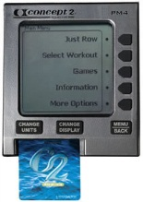
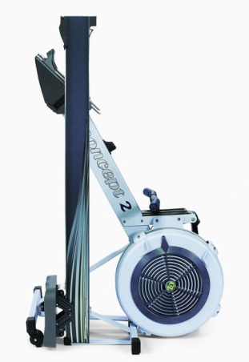
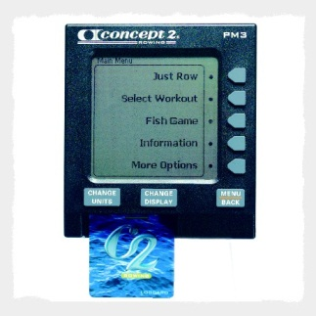
SWEAT ERG Reservations 2015
To reserve an erg, payment must be made in advance
To reserve an erg, please fill out the 2015 Erg Order form
Forms and payment must be received by December 30th
Ergs must be picked up between 3PM and 5PM on the day of SWEAT (new ergs available immediately after the final event)
Additional ERGs will be sold at SWEAT, however availability is not guaranteed and are on a first come-first served basis
$850 - Exclusive Race Build New Concept D with PM 5 Monitor
(does not include rechargeable battery or heart rate monitor)
$775 - Used Concept D with PM 3/4 Monitor (2012 models)
For reservations and inquiries, please contact Kurt Hofmeister at Kurt@driftinc.com

